Slide 1

Power to the puffs
Lori, Lauren and Tierra

Slide 2

Objective
Found an easier solution to filtering the orders from different sources and how to accommodate for them.
Also assuring that subscribers are still subscribed and helping the system be more efficient.

Slide 3
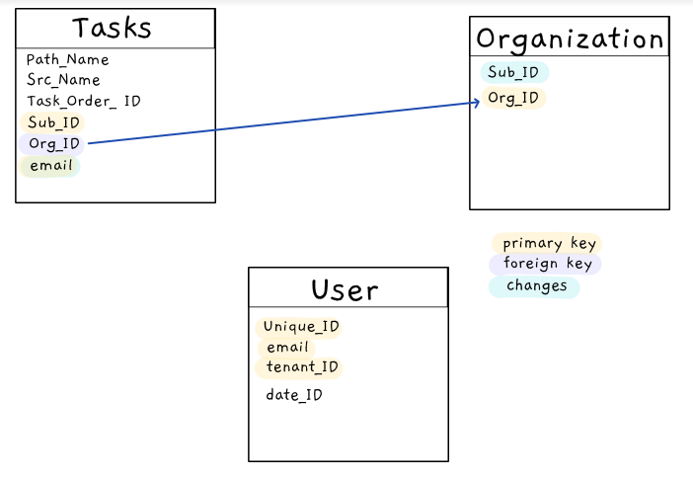


Slide 4

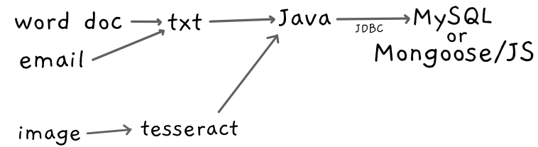

Slide 5

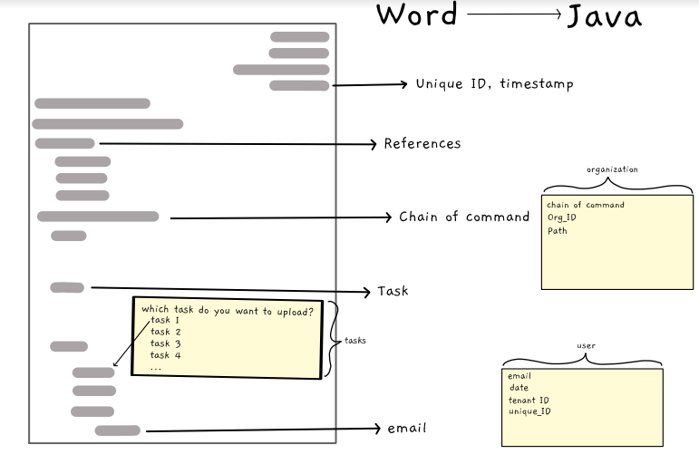

Slide 6
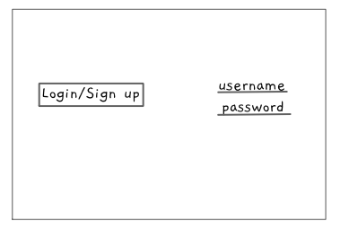

Implementation

Slide 7
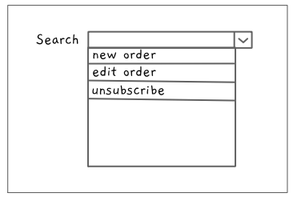


Slide 8
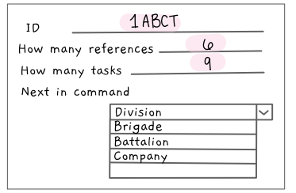


Slide 9
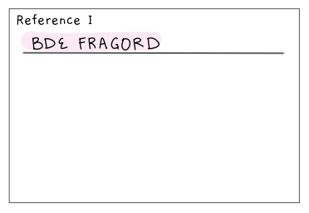


Slide 10
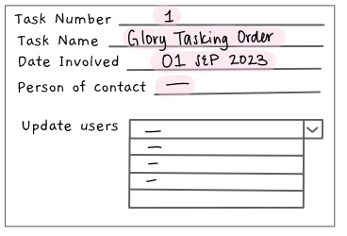


Slide 11
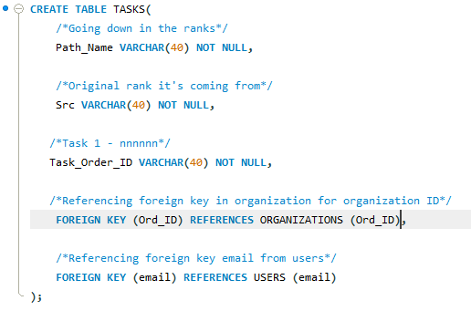

Slide 12
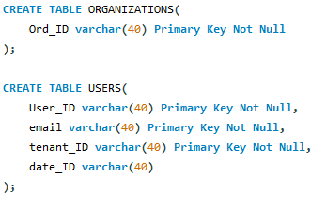

Slide 13
